Slide 1
Internet Protocol

Slide 2
Internet Protocol (IP)
We saw that the Internet is a network of networks connected by cables
Now, how do these networks and devices communicate with each other?
Don’t want to broadcast our data to everyone on the Internet
To connect to a specific server on the Internet we use the Internet Protocol
Official standard for IPv4: https://tools.ietf.org/html/rfc760
IP address
Every device connected to the Internet has an IP address
That device’s “location” on the Internet
To connect to specific device, send data to its IP address
Similar to send mail to a street address in the physical world

Slide 3
Internet Protocol
Data is sent in packets
Each packet contains a header and a payload
Header
Contains metadata about the packet
Most importantly, contains the source and destination IP addresses
Payload
The data to be send to the destination device
IP has no concern about the content of the payload
IP is only concerns about delivering the payload to its destination
Payload often/always follows additional protocols agreed upon by the source and destination
Ex: TCP, UDP, HTTP
Payload is often encrypted

Slide 4
IP
Address of a machine on the Internet
Ex: 172.217.12.211
Routers read the address and send it to the next step
Often read a prefix
IPs with a common prefix are related
Two parts: Network, host
Organizations will receive a prefix and own all IP’s that start with that prefix
One of Google’s ranges: 172.217.0.0-172.217.255.255
Network prefix: 172.217.x.x

Slide 5
IP
IPv4 (8.8.4.4)
Consists of 4 numbers ranging from 0 to 255
How many total addresses?
4 numbers, 8 bits each, 32 total bits, 2^32 total addresses
4,294,967,296
A lot, but not enough
IPv6 (2001:4860:4860:0000:0000:0000:0000:8844)
128 bit addresses
2^128 total addresses
340,282,366,920,938,463,463,374,607,431,768,211,456
That should be enough
Used in conjunction with IPv4
Routers must be able to route both versions

Slide 6
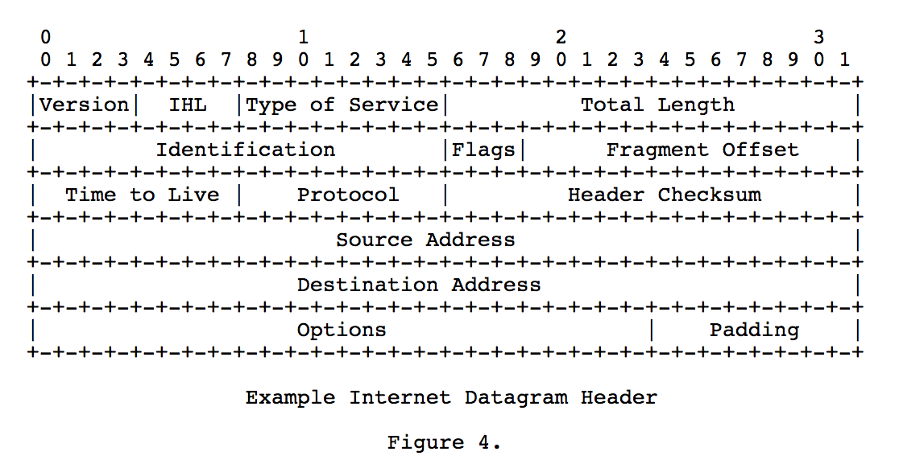
From the IPv4 official standard: https://tools.ietf.org/html/rfc791

Slide 7
Domain Name Service (DNS)
We don’t want to remember IP address for all our favorite sites
With DNS, we don’t have to
DNS
Remember a Domain Name instead of an IP address
Domain Name: google.com
When you click a link, first a DNS request is made to get the IP address for that Domain Name
Then the IP address is used to make your request
Can access sites directly by IP
http://172.217.6.228/
Not all sites allow direct IP access
http://104.16.40.2/

Slide 8
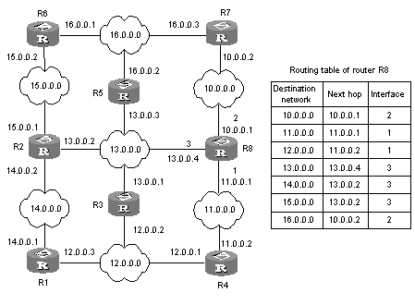
Routing Through the Internet
ISP and Tier 1 networks contain many routers to direct Internet traffic
These routers are made for speed!
To maximize speed, they are simple
The complexity of the Internet is in the users and CDNs
Router reads the destination IP address of a packet and sends it to the next router
Only knows the next step
No one needs to map the entire Internet
Networks change
Routing tables can be updated
https://superuser.com/questions/959242/how-is-next-hop-defined-in-routing-table

Slide 9
Transmission Control Protocol (TCP)
The Internet is unreliable
Router sends a packet to its next step, then forgets about it
May have sent packets to a failed router
Cables may be cut
Regions can have power outages
Router never gets confirmation of delivery even if the packet made it to its destination
Internet users and CDNs are responsible for reliability
How?
Timeout
TCP

Slide 10
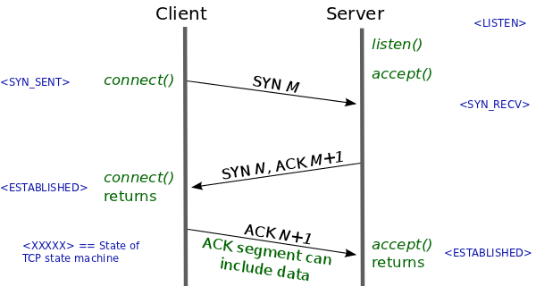
TCP: Making a Connection
3-way handshake to confirm a connection
SYN
Client sends a packet with a random number to the server
SYN-ACK
Server acknowledges that it received the client’s SYN by returning the random number+1
Also send another random number
ACK
Client returns the server's random number plus 1
After all three steps, boths side have verified the connection
https://lwn.net/Articles/508865/

Slide 11
TCP: Transmitting Data
Data is often too large for a single packet
Divide data into smaller packets
Receiver reassembles the packets on the other side of the Internet
Once a connection is established, send all the packets
Packets can arrive out of order
Each packet contains a sequence number for reordering
If a sequence number is missing, request a resend
Many streams simultaneously
TCP uses port numbers
Port number routes communication at the machine level
Different programs communicate with different ports
Allows multiple programs to all use the Internet
Ex: Web browsers use ports 80 and 443

Slide 12
Live Demos
How long does it take to load a website? (Browser console)
What’s the path of a packet? (Traceroute)

Slide 13
A Thought on Security and Privacy
How to secure your data and protect your privacy?
Encryption!
More later
No matter how you encrypt your data, your ISP and Tier 1 networks must always know 2 things:
Source IP Address
Destination IP Address
Therefore: They HAVE to know what servers you’re connecting to, even if they don’t know what you are saying

Slide 14
A Thought on Security and Privacy (VPN)
Virtual Private Network (VPN)
Originally used to connect to a network remotely (ex. UB’s AnyConnect)
Commonly used to “Bounce” web requests off the remote server
The VPN can send requests on your behalf and return the response to you
Can increase privacy
Can effectively scramble communication if many users go through the same VPN
Does not ensure privacy
Must trust the VPN provider
Routers still know you’re connecting to a VPN
CDNs can block traffic from known VPN IP addresses
Important: This is not a violation of net neutrality since CDNs are not ISPs!

